Slide 1
Lecture 23
Sensor

Slide 2
Introduction
Most of the android devices have built-in sensors and its start from Android 1.3 version.
Which measure motion, orientation, and various environmental condition.
The android platform supports 3 broad categories of sensors:-
Motion Sensors
Environmental sensors
Position sensors
Some of the sensors are hardware based and some are software based sensors.
Android provides SensorManager and Sensor classes to use the sensors in our application.

Slide 3
Steps to use Sensor
To use sensors , firstly we need to create the object of SensorManager class by using this code:-
SensorManager sm = (SensorManager)getSystemService(Context.SENSOR_SERVICE);
2. Next, we need to create the object of Sensor class by calling the getDefaultSensor() method of the SensorManager class by using this code:-
Sensor s = sm.getDefaultSensor(Sensor.TYPE_LIGHT);
Once that sensor is declared , we need to register its listener and override two methods which are onAccuracyChanged and onSensorChanged.
sm.registerListener(this, s, SensorManager.SENSOR_DELAY_NORMAL);
public void onAccuracyChanged(Sensor s, int accuracy) { }
public void onSensorChanged(SensorEvent e) { }

Slide 4
Others Method of Sensor Manager Class
getDefaultSensor(int i):- This method get the default sensor for a given type.
registerListener(SensorListener l, int sensors, int rate):- This method registers a listener for the sensor.
unregisterListener(SensorEventListener l, Sensor s):- This method unregisters a listener for the sensors with which it is registered.
getOrientation(float[] R, float[] values):- This method computes the device's orientation based on the rotation matrix.
getAltitude(float p1, float p2)This method computes the Altitude in meters from the atmospheric pressure and the pressure at sea level.

Slide 5
Get List of Sensors supported by our device
Take a Project by name “SensorListApp”.
Take a TextView in your XML file.
Now work on your Java File for getting list of Sensors which are supported by our device in a TextView.

Slide 6
Code of MainActivity.java
public class MainActivity extends Activity {
TextView tv;
String s = “ ”;
protected void onCreate(Bundle savedInstanceState) {
super.onCreate(savedInstanceState);
setContentView(R.layout.activity_main);
tv = (TextView)findViewById(R.id.textView1);
SensorManager sm = (SensorManager)getSystemService(Context.SENSOR_SERVICE);
List<Sensor> myList= sm.getSensorList(Sensor.TYPE_ALL);
for (int i = 1; i < myList.size(); i++) {
s = s + myList.get(i).getName() + "\n" +
myList.get(i).getVendor() + "\n" +
myList.get(i).getVersion() + "\n";
}
tv.setText(s);
}
}

Slide 7
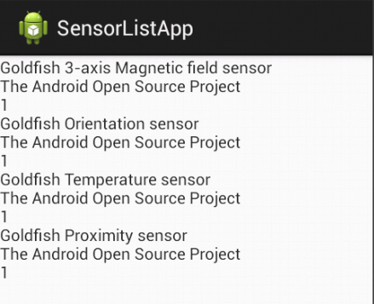
Output
There is a List of all supported sensor by our device:-

